Slide 1
Akhil Bhardwaj / Anuraag Dash
03 October at ISB.
Using AI for PM Decks.

Slide 2
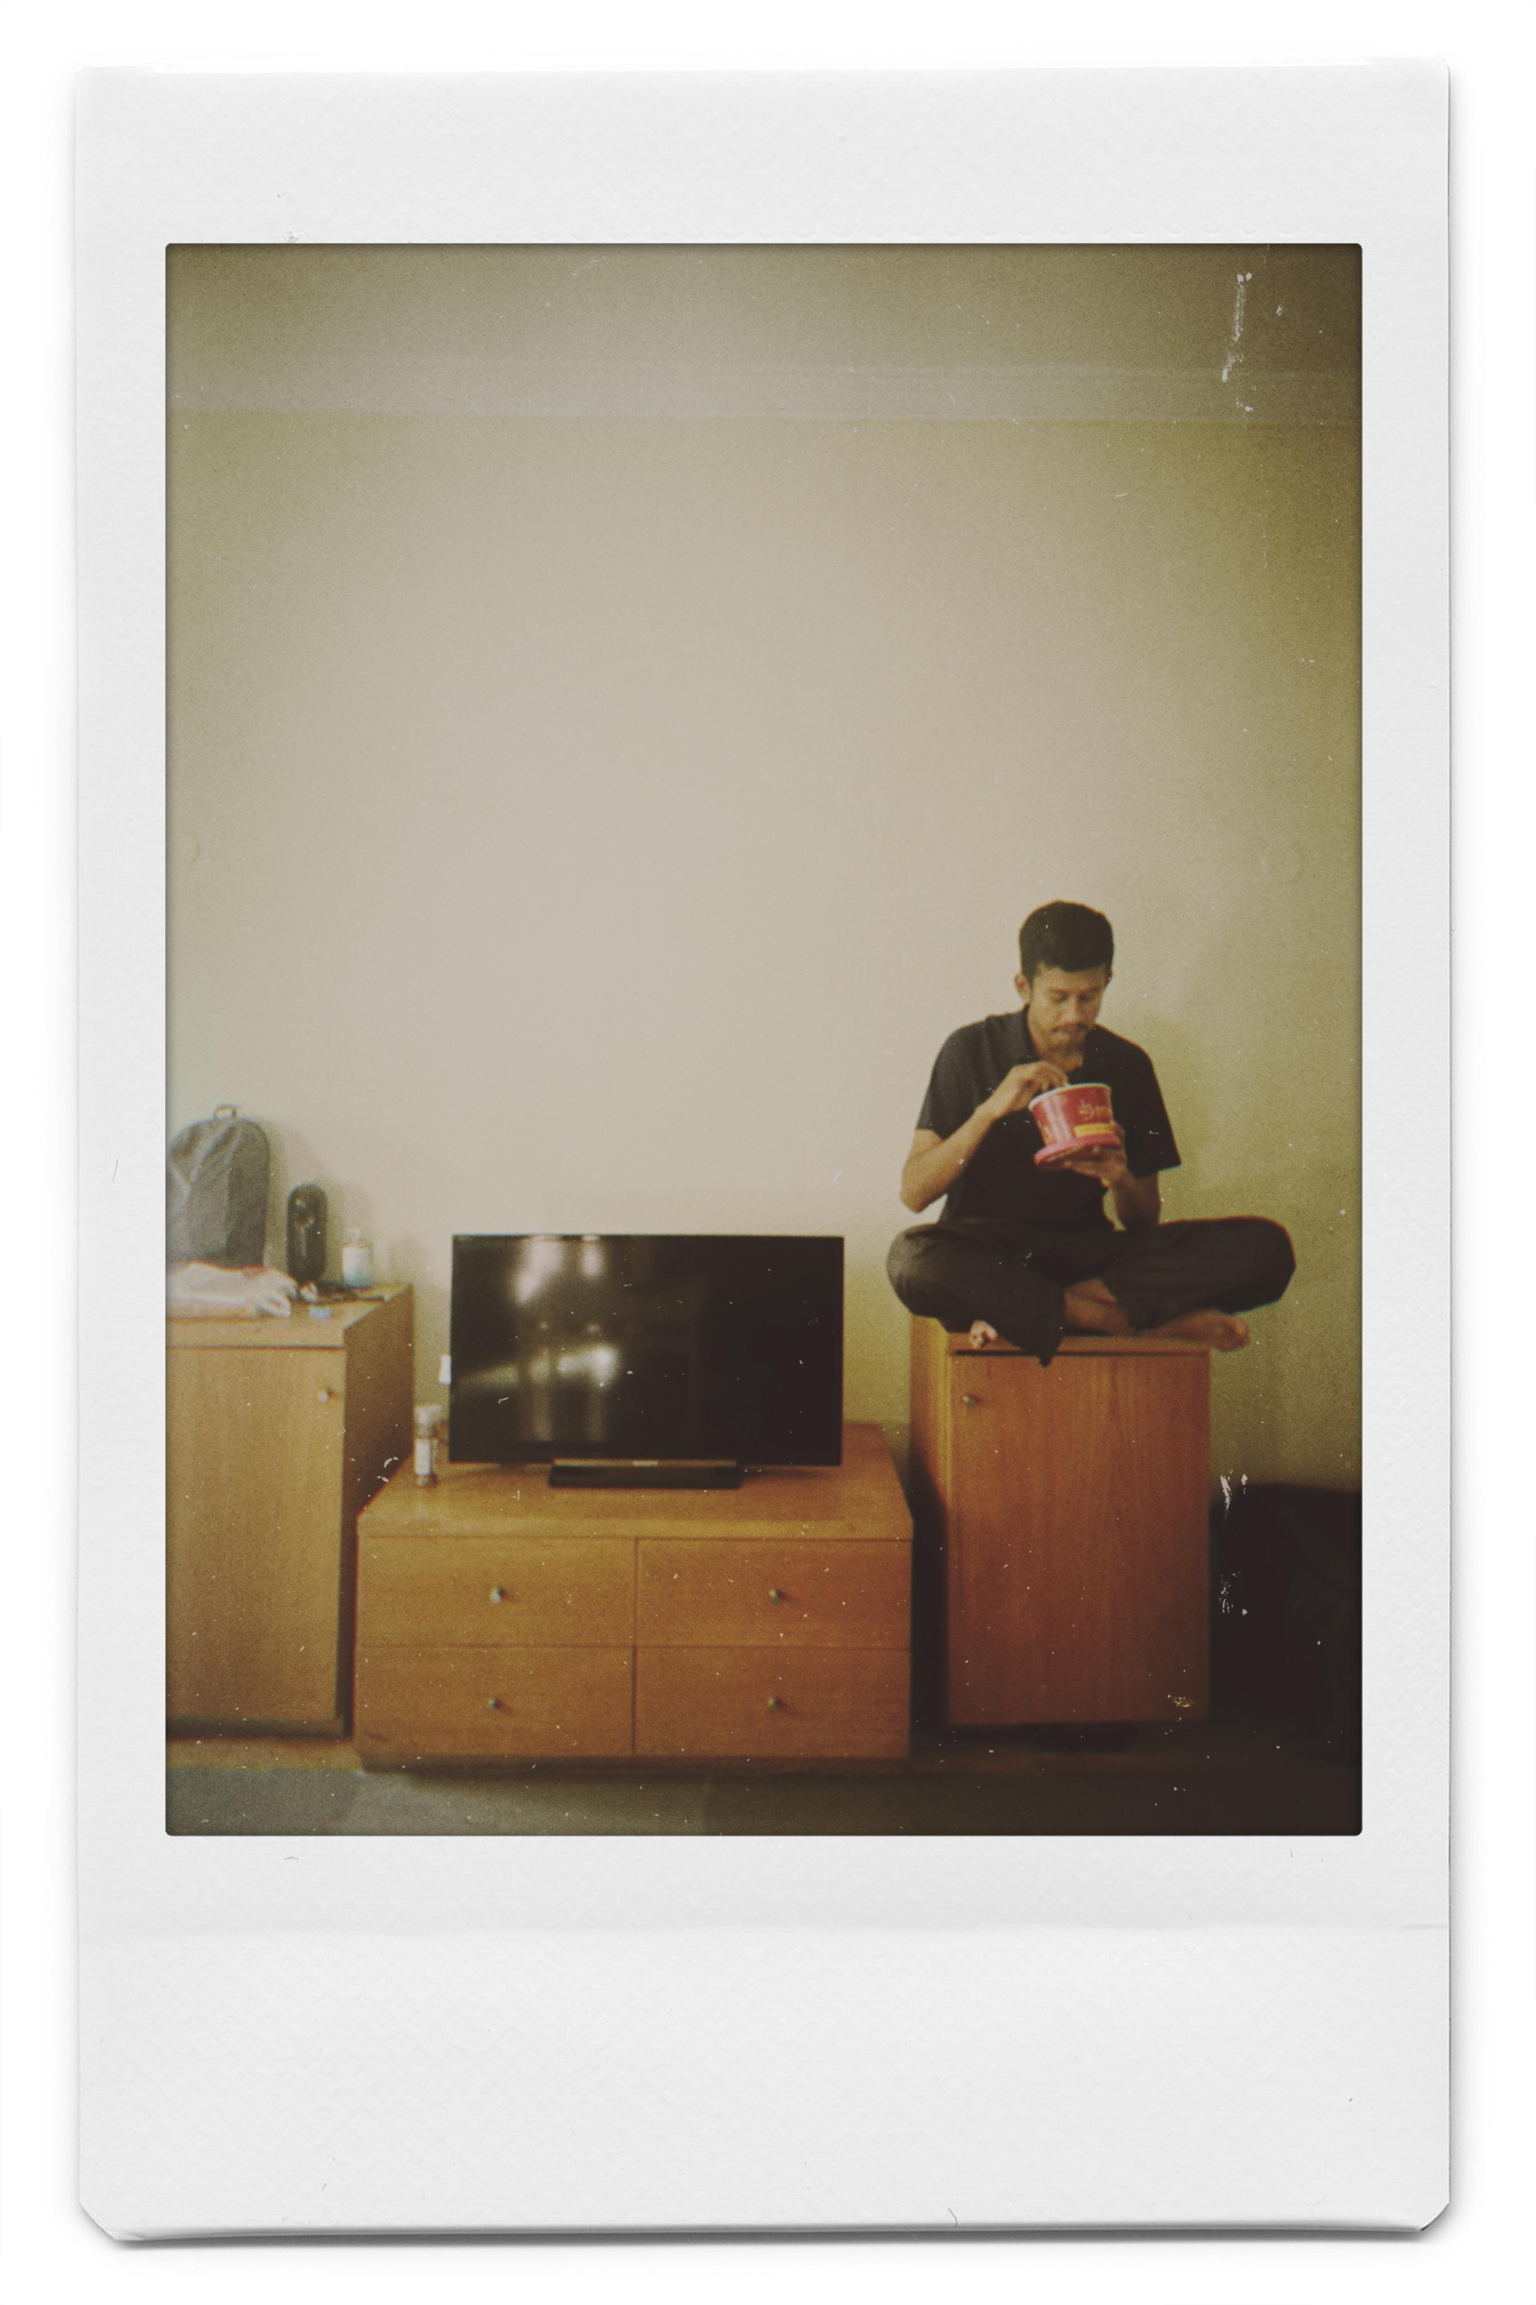

You’re interacting with
Akhil
(Makes pretty slides)
AI Product Manager, BCG X
Before ISB:
Created board games at his startup (UNBOX Games)
Private equity consulting at Capitel
At ISB:
AI SIG, 3 case comp wins
Exhausting amounts of fun
Met Anuraag Dash.
Anuraag
(Sells saabun and Surf)
Brand Manager, HUL
Before ISB:
Managed a plant at Tata Steel
Built and managed communities at Reddit
At ISB:
ACED acads
Started up AxiomShift
Together, we…
Scaled AxiomShift together (before Claude Code wiped us out)
8+ years of combined experience in communicating our ideas through decks

Slide 3
*and that’s the crux of this presentation – how to rely on yourself.
This deck is not AI generated*

Slide 4
Two parts to a good deck…
COMMUNICATING your idea
Communicating your IDEA

Slide 5
AI is good at neither without direction.

Slide 6
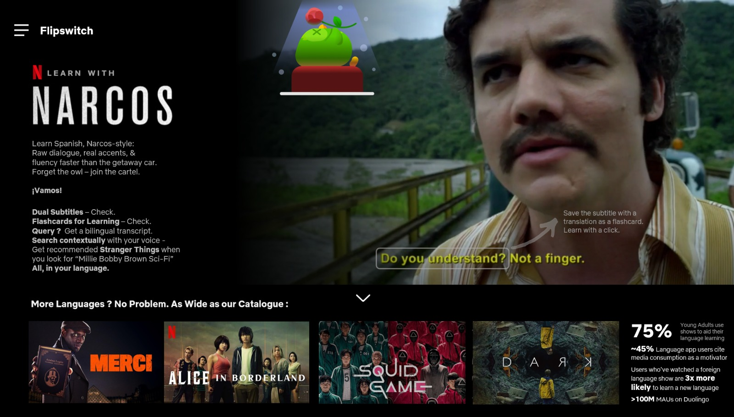
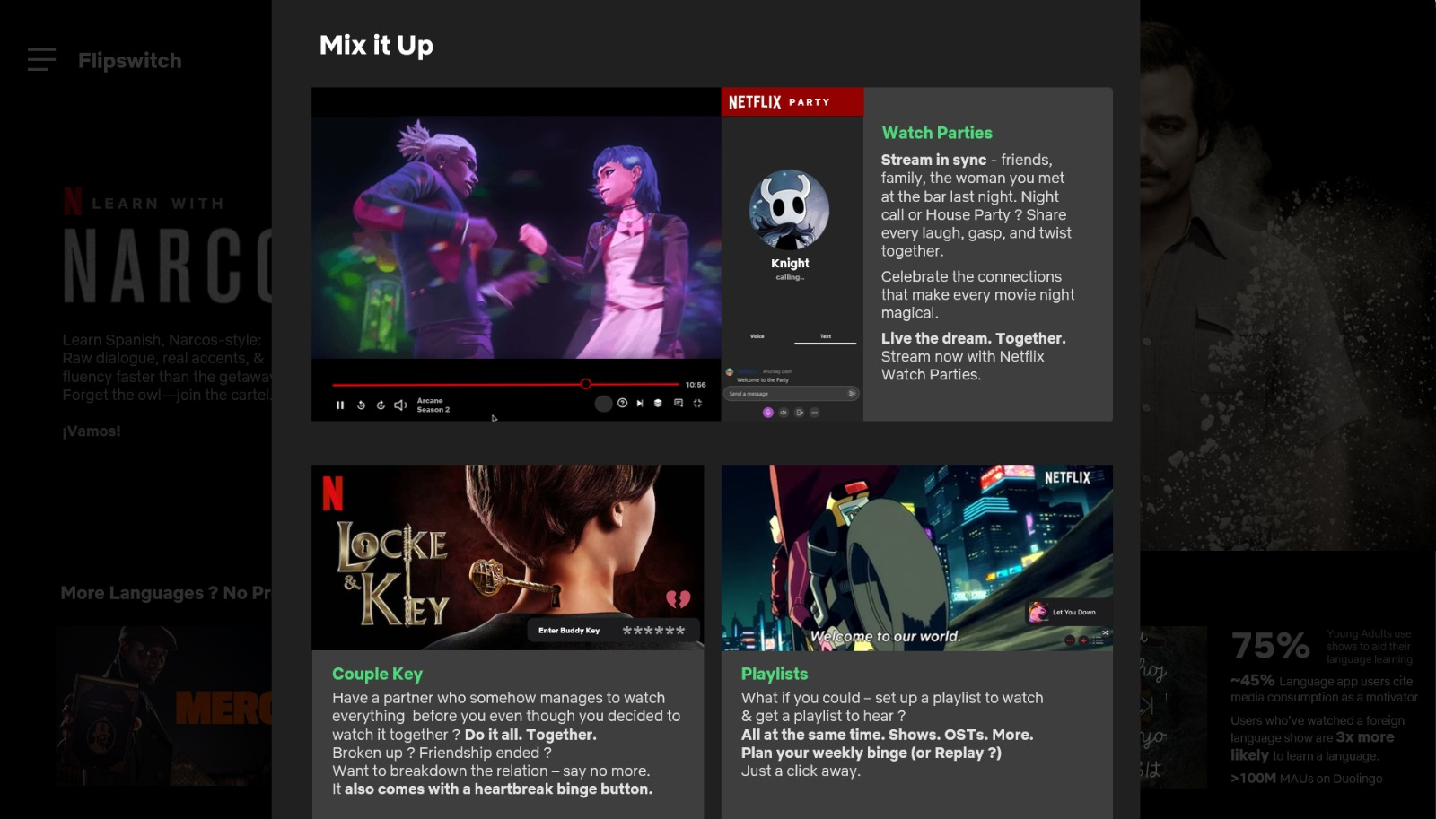
Communication = Design + Impact
COMMUNICATING your idea
Embed solution in user experience to give a feel of the end product
Renders are easier than ever with AI

Slide 7


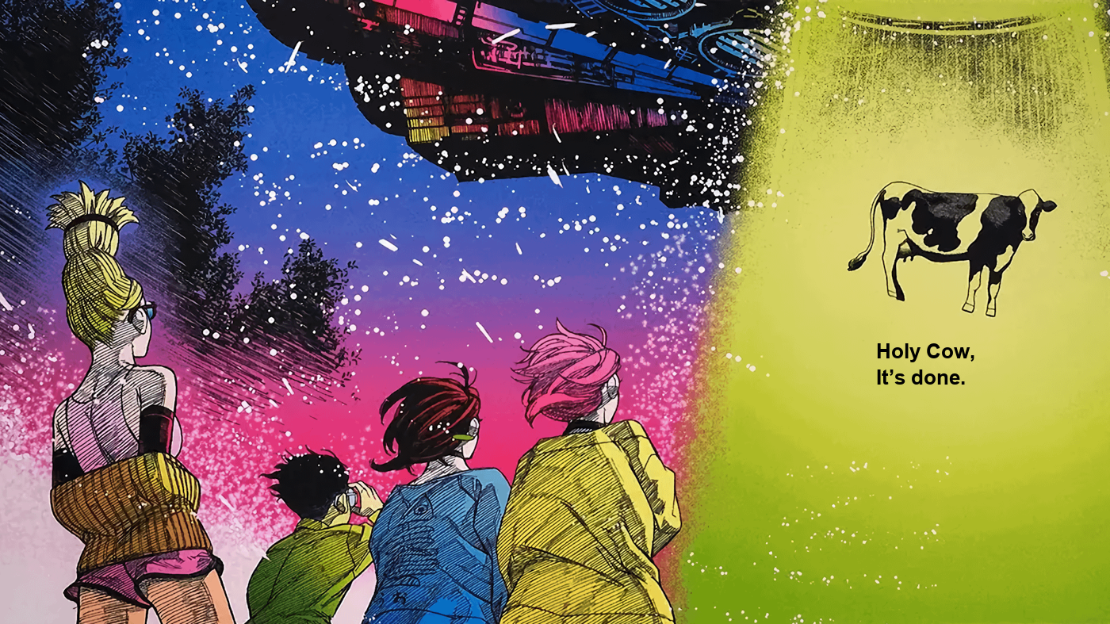
Communication = Design + Impact
COMMUNICATING your idea
One photo, one line. That's the whole slide.
No "key takeaways". Just a line you'll actually remember.

Slide 8
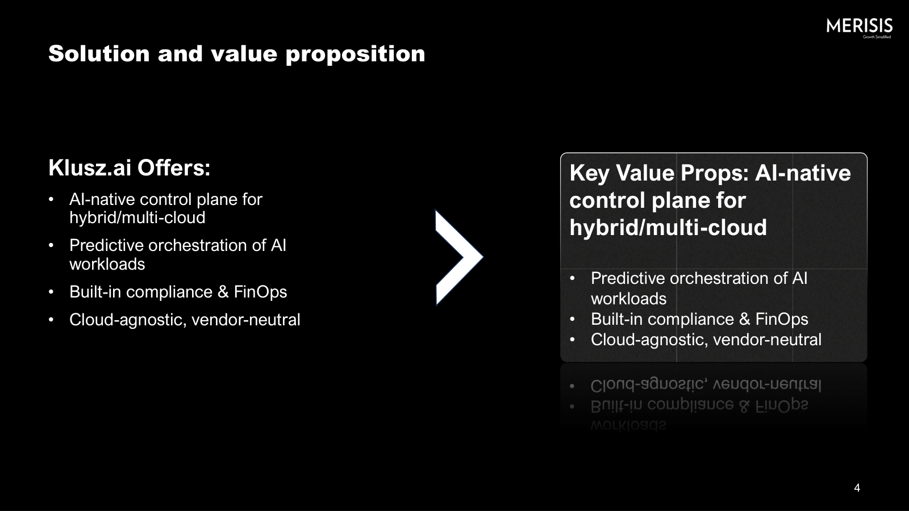
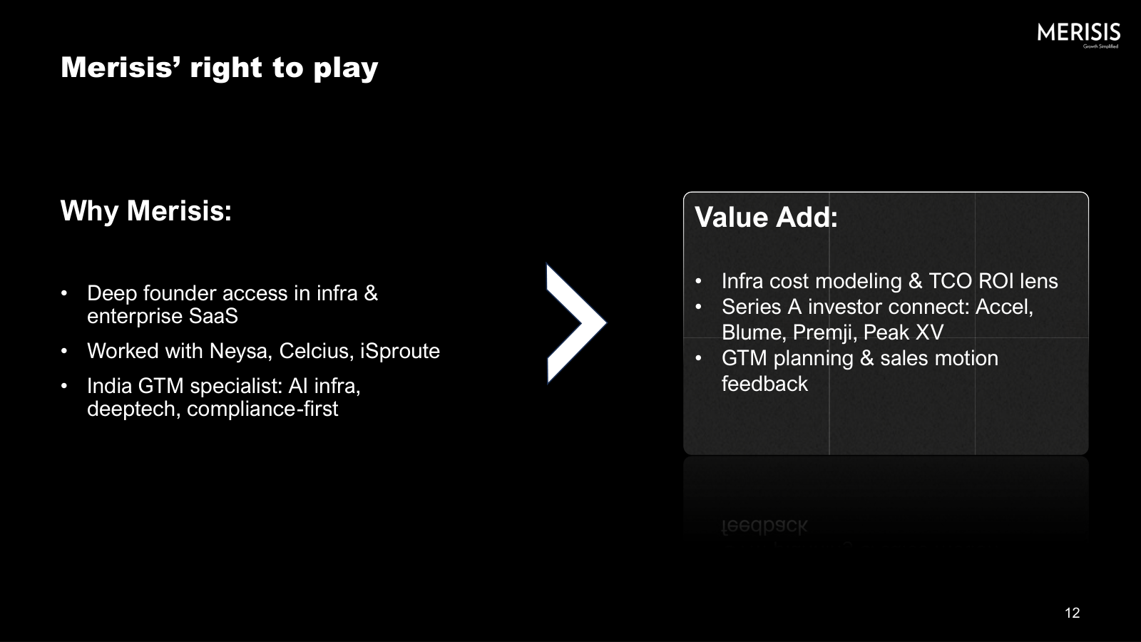
AI sucks at designing human slides
COMMUNICATING your idea
Two boxes and a chevron. The template decided this, not me.
Eight slides later, same chevron.

Slide 9
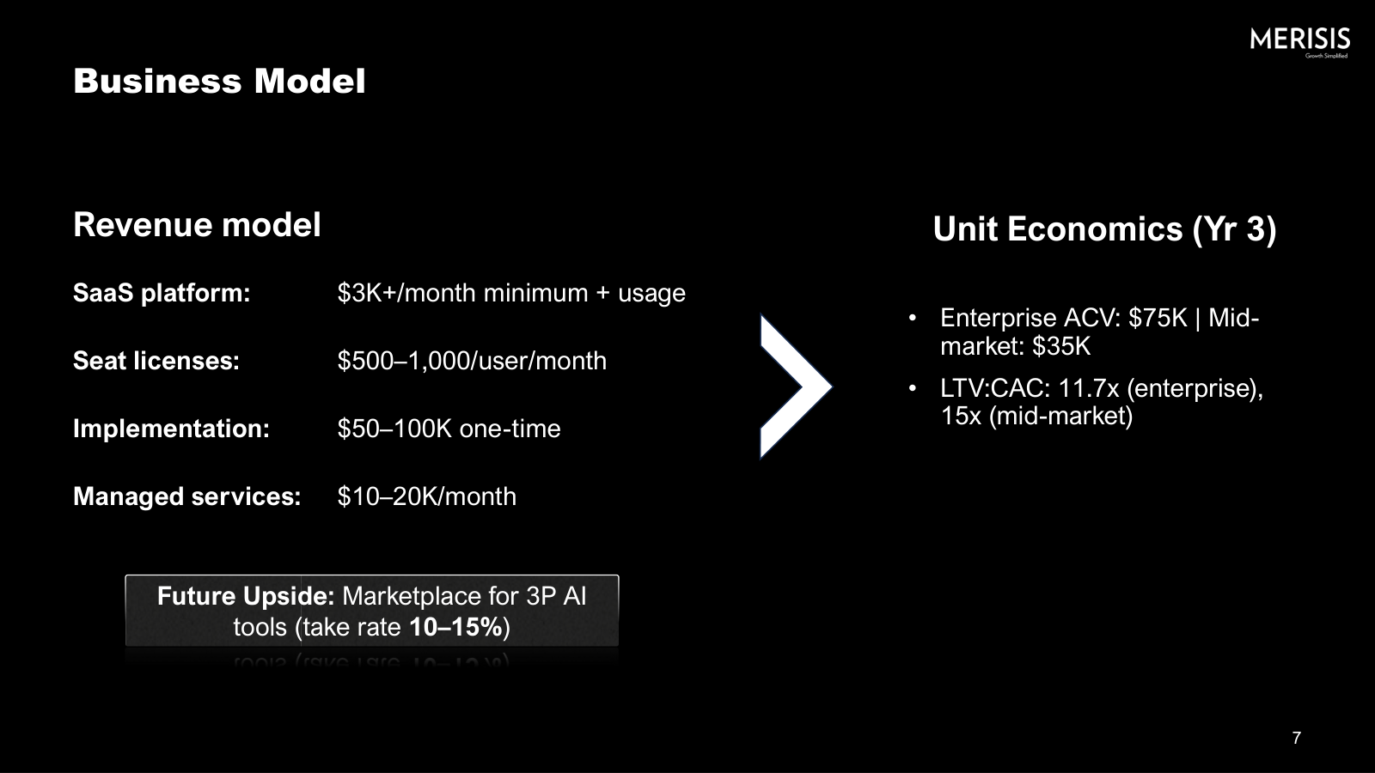
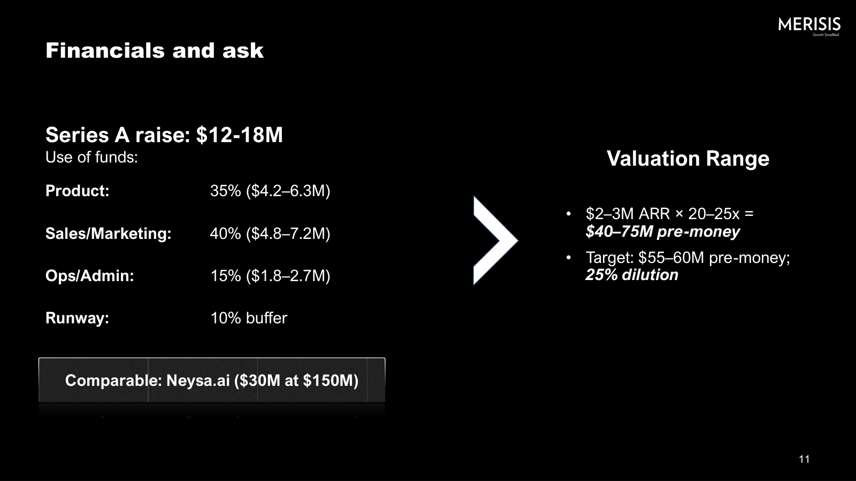
We bias our neural pathways early
COMMUNICATING your idea
Slide 4. I picked this layout once.
Slide 7. Still the same layout.
Slide 11. I wasn't designing anymore, I was filling boxes.

Slide 10
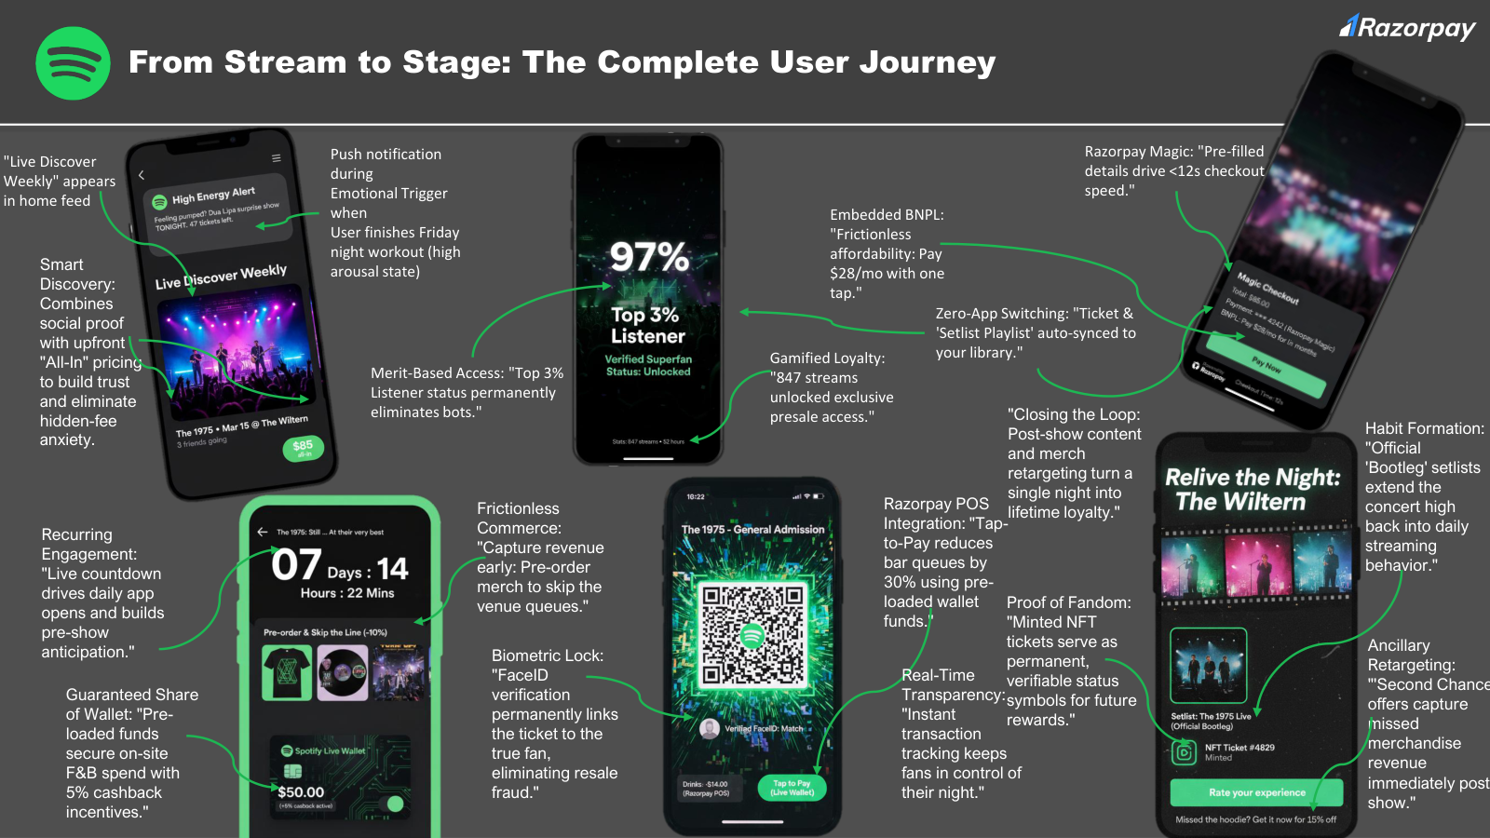
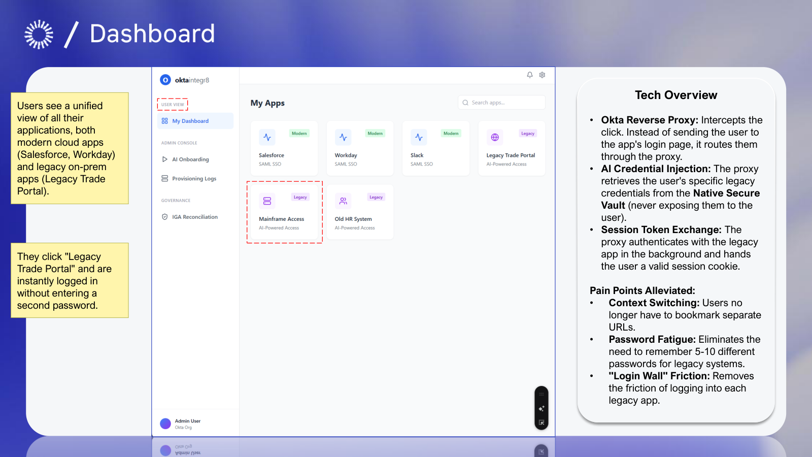
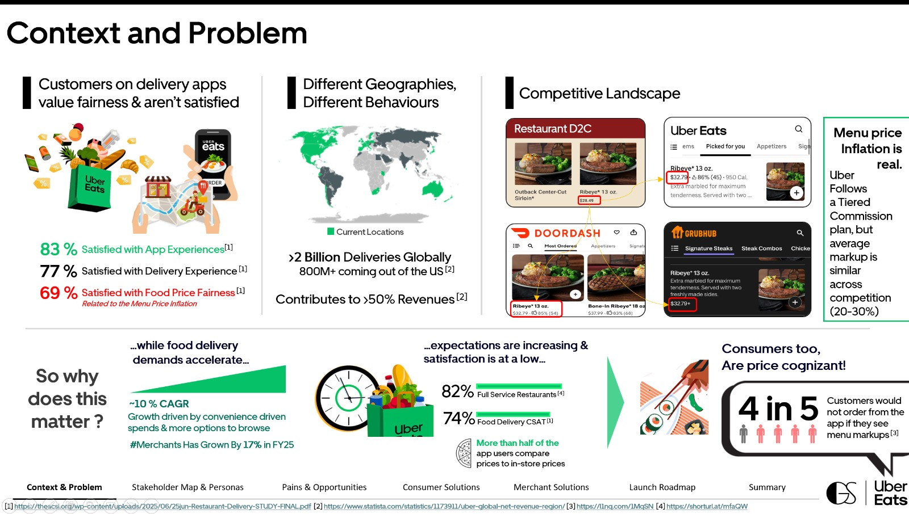
Intuitive slide design always wins
COMMUNICATING your idea
You read the whole journey without reading a word.
Show the screen. Point at it. No paragraph needed.
Four kinds of proof on one page and it still breathes.

Slide 11
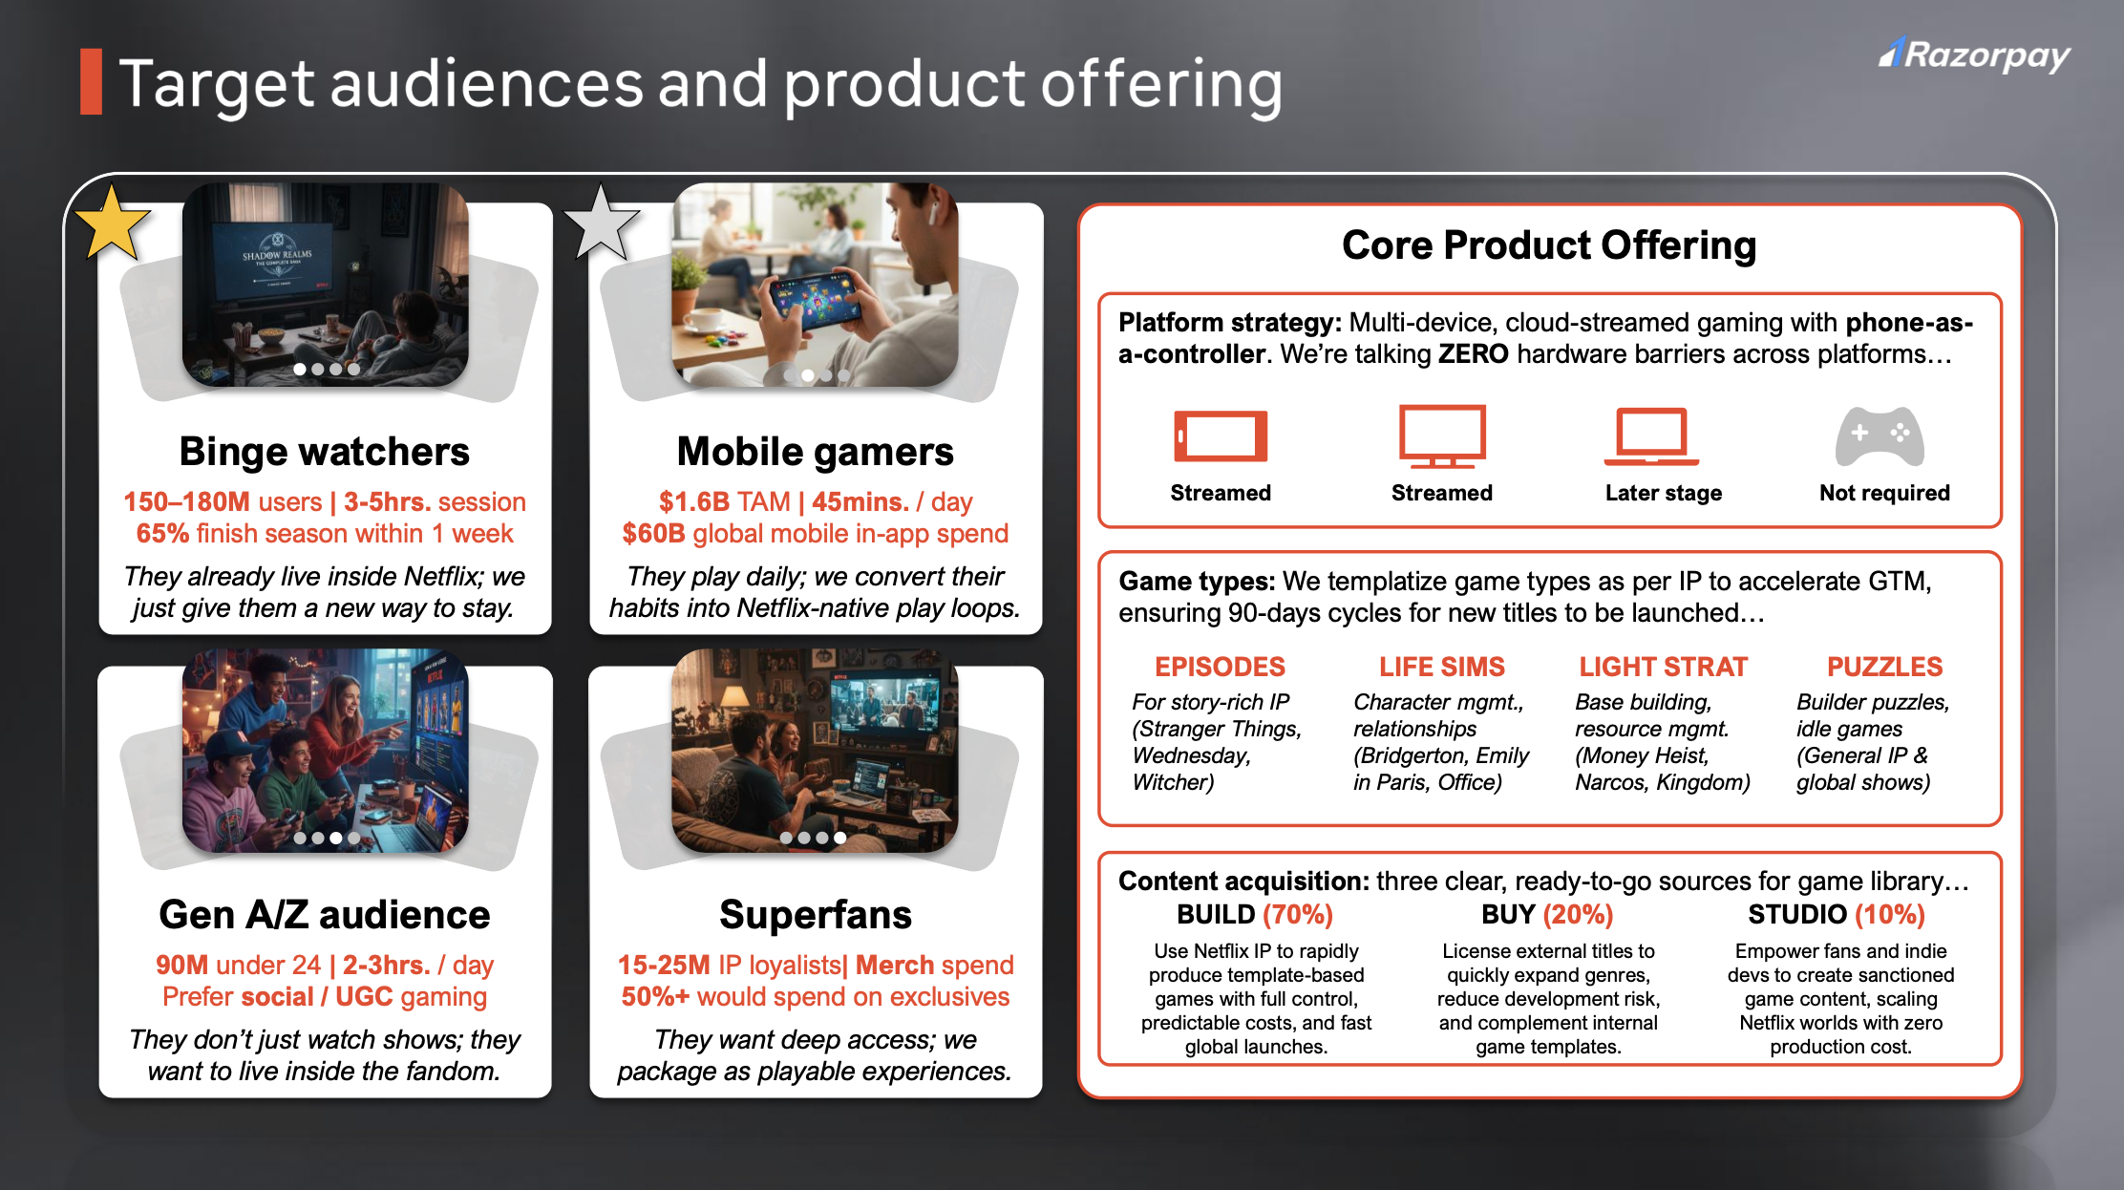
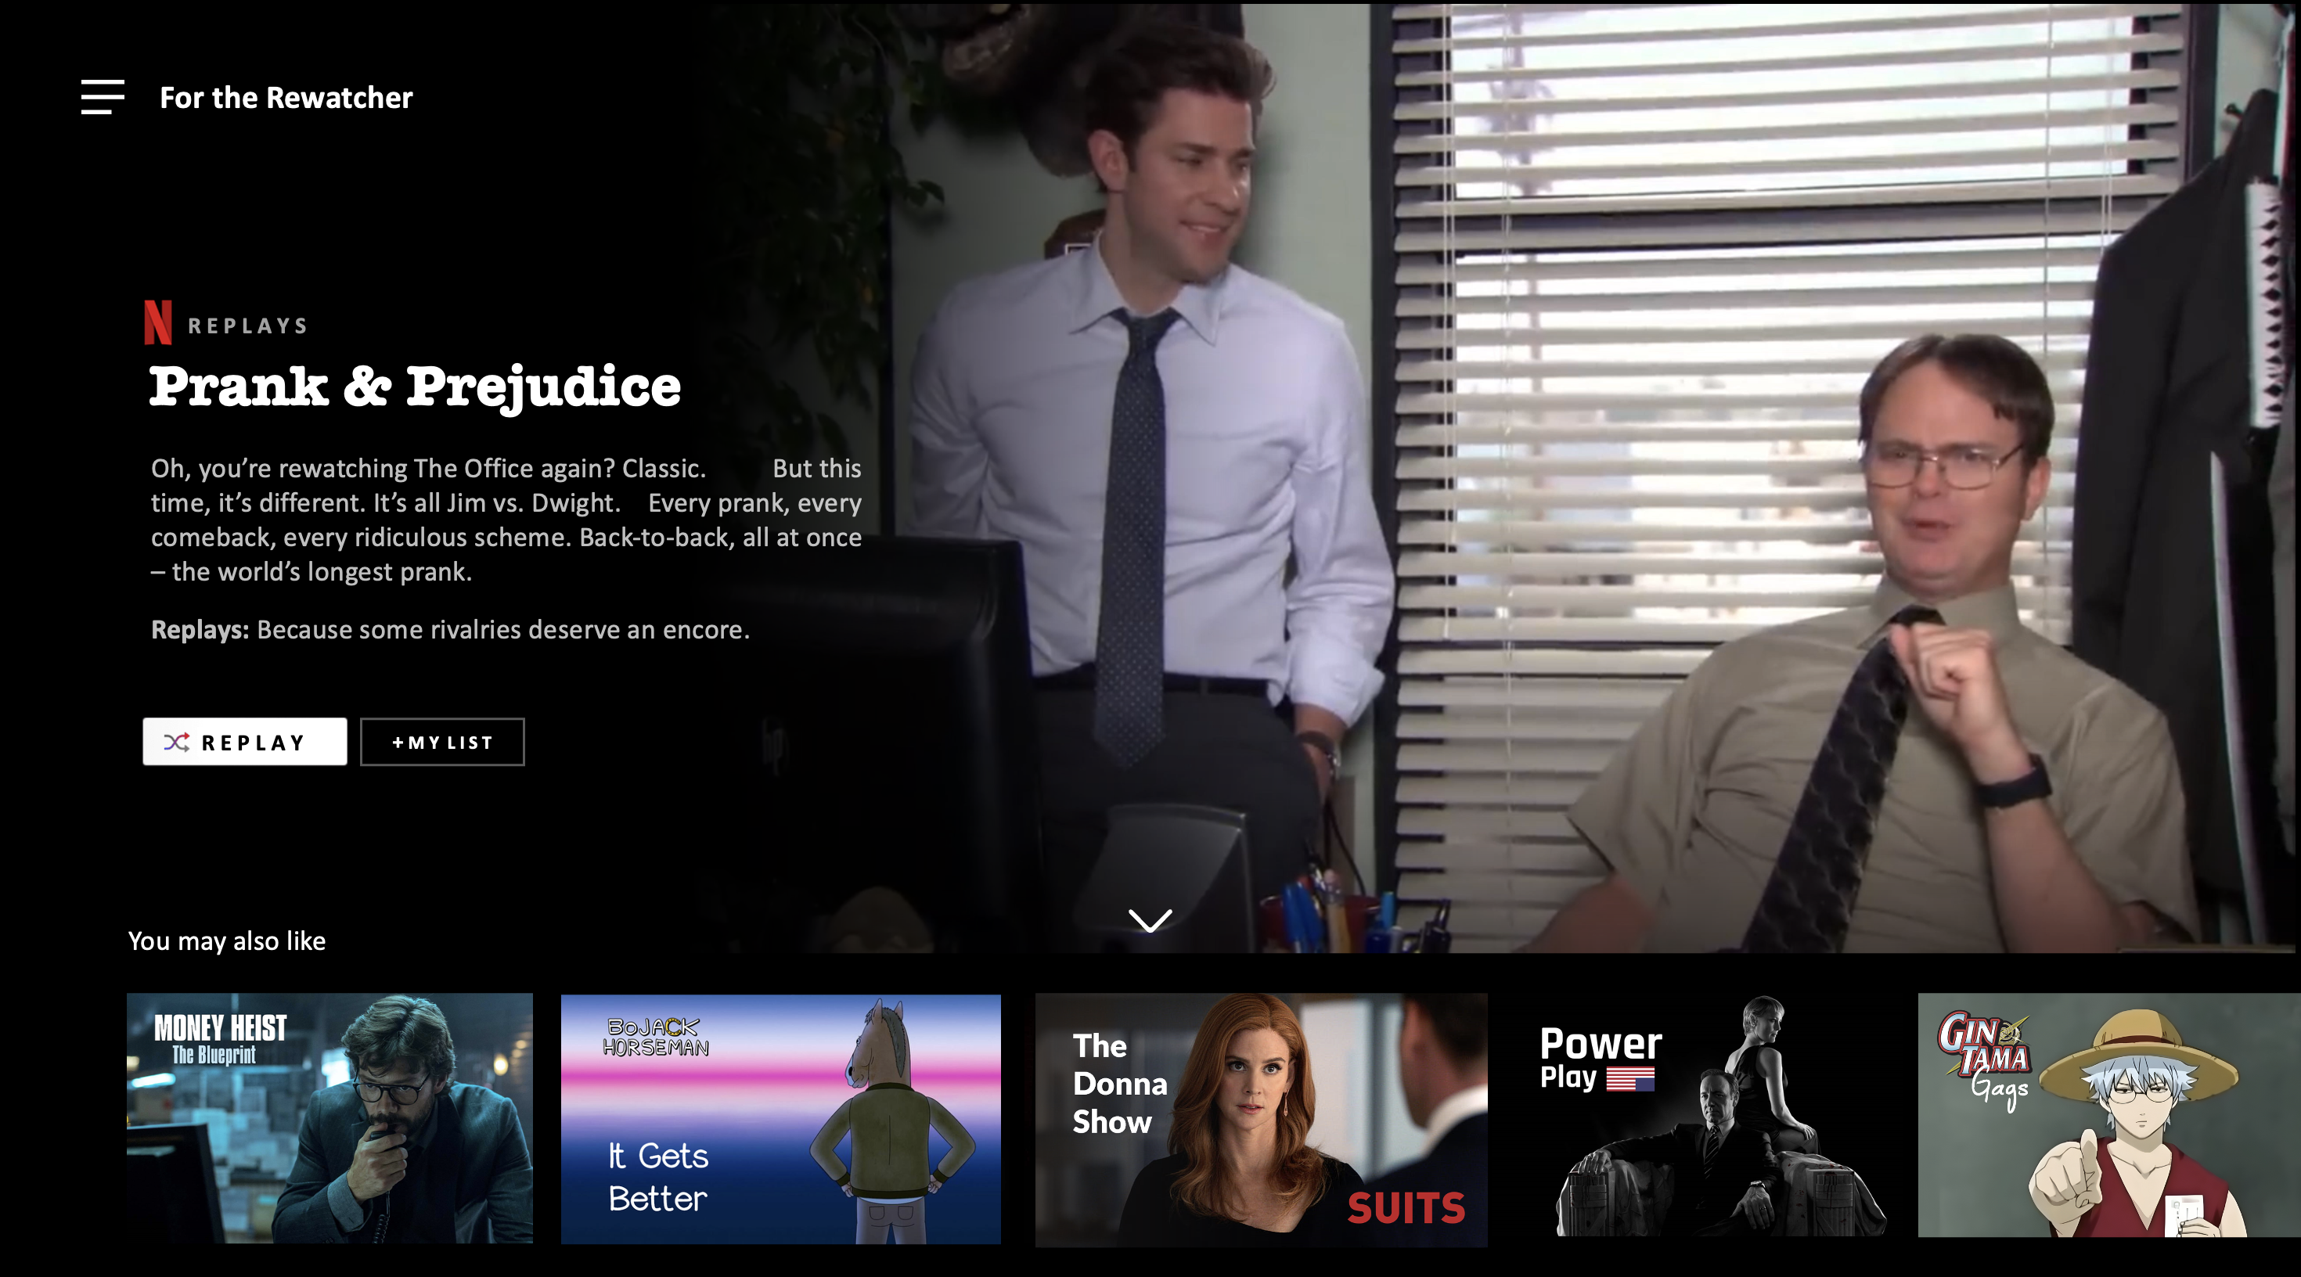
Idea = Content + Tone
Communicating your IDEA
Designed like the user would experience it.
Written like Netflix would write it

Slide 12
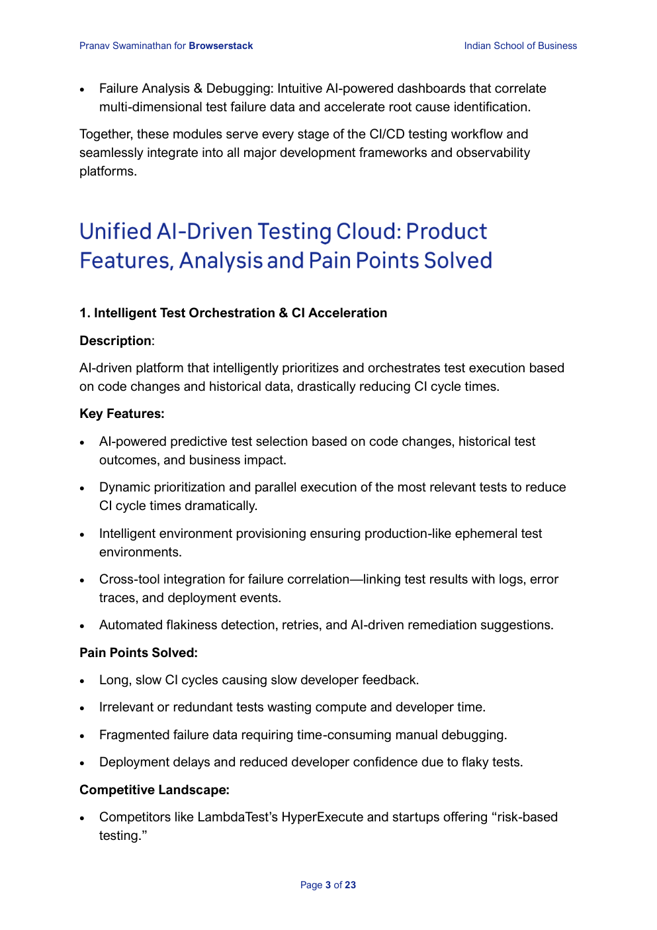
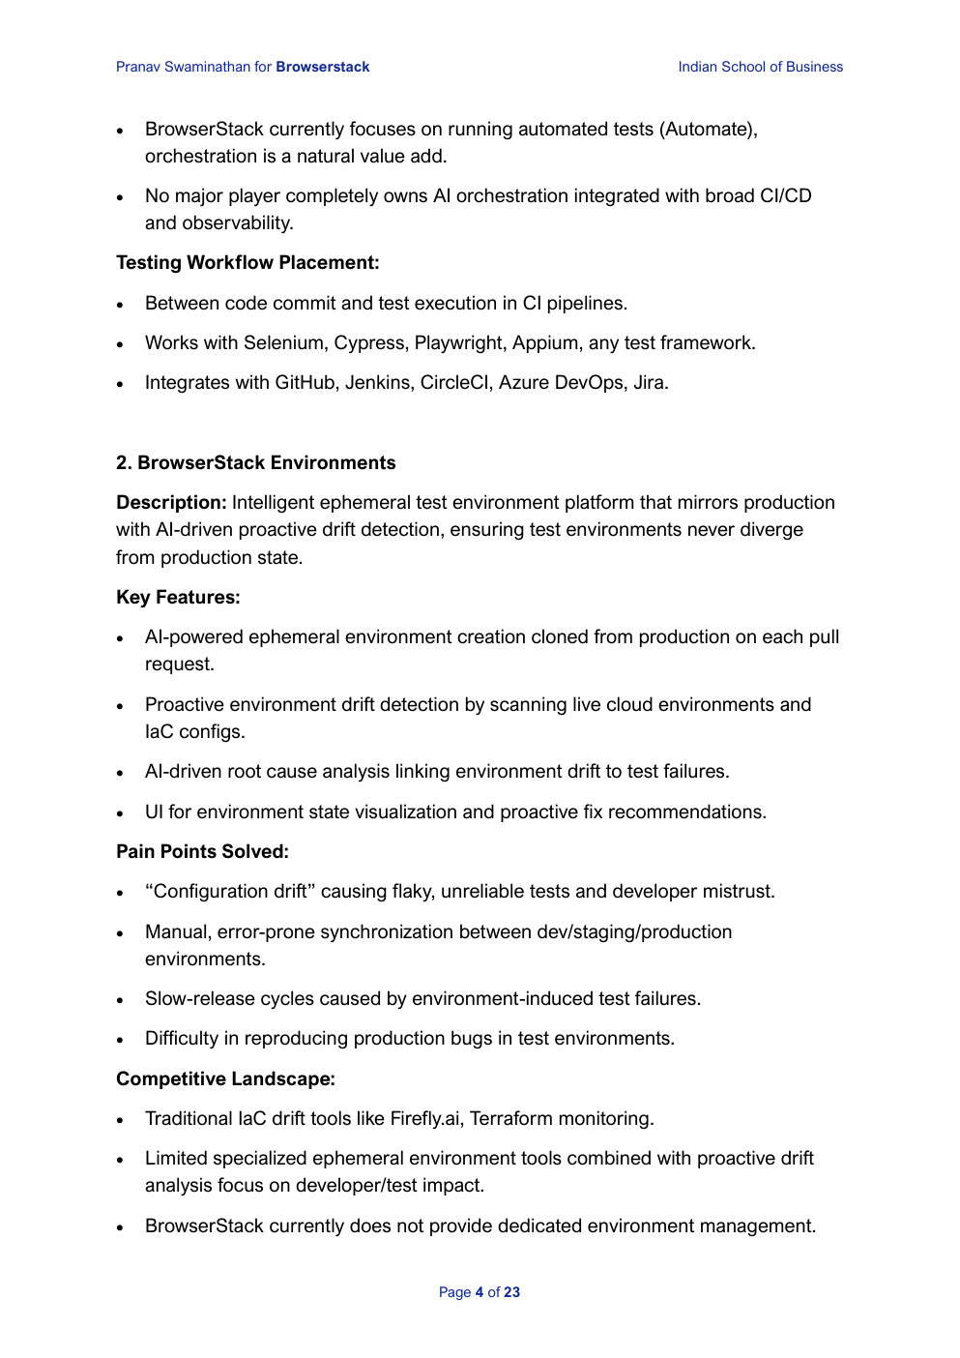
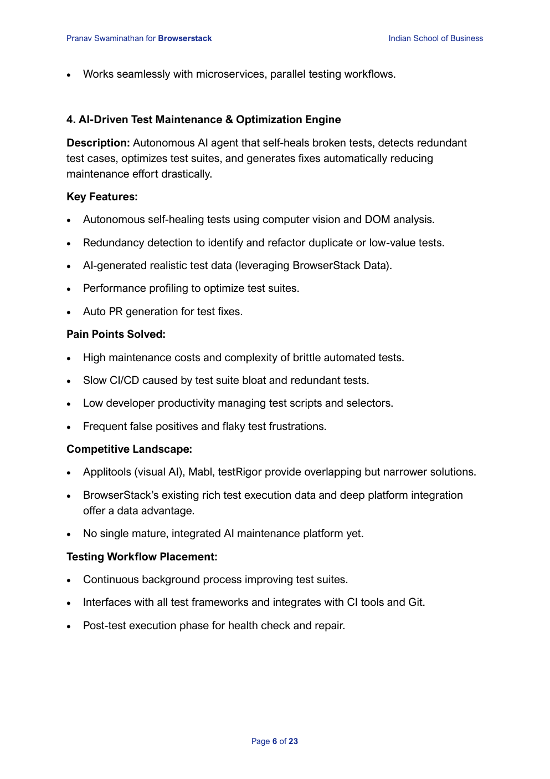
AI slop is easier to detect than ever
Communicating your IDEA
Description, key features, pain points, competitive landscape.
Same four headers. Again.
Five times. That rhythm gives it away.

Slide 13
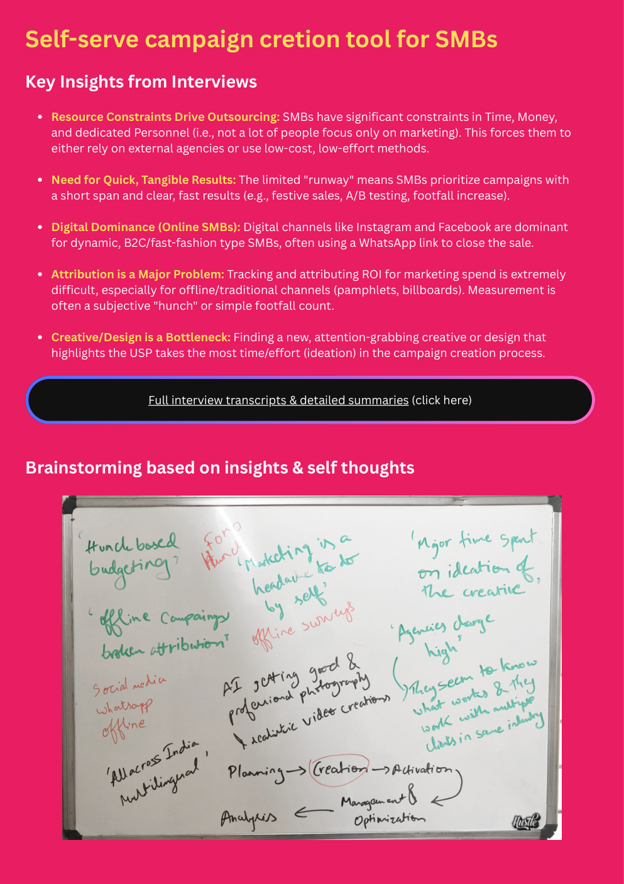
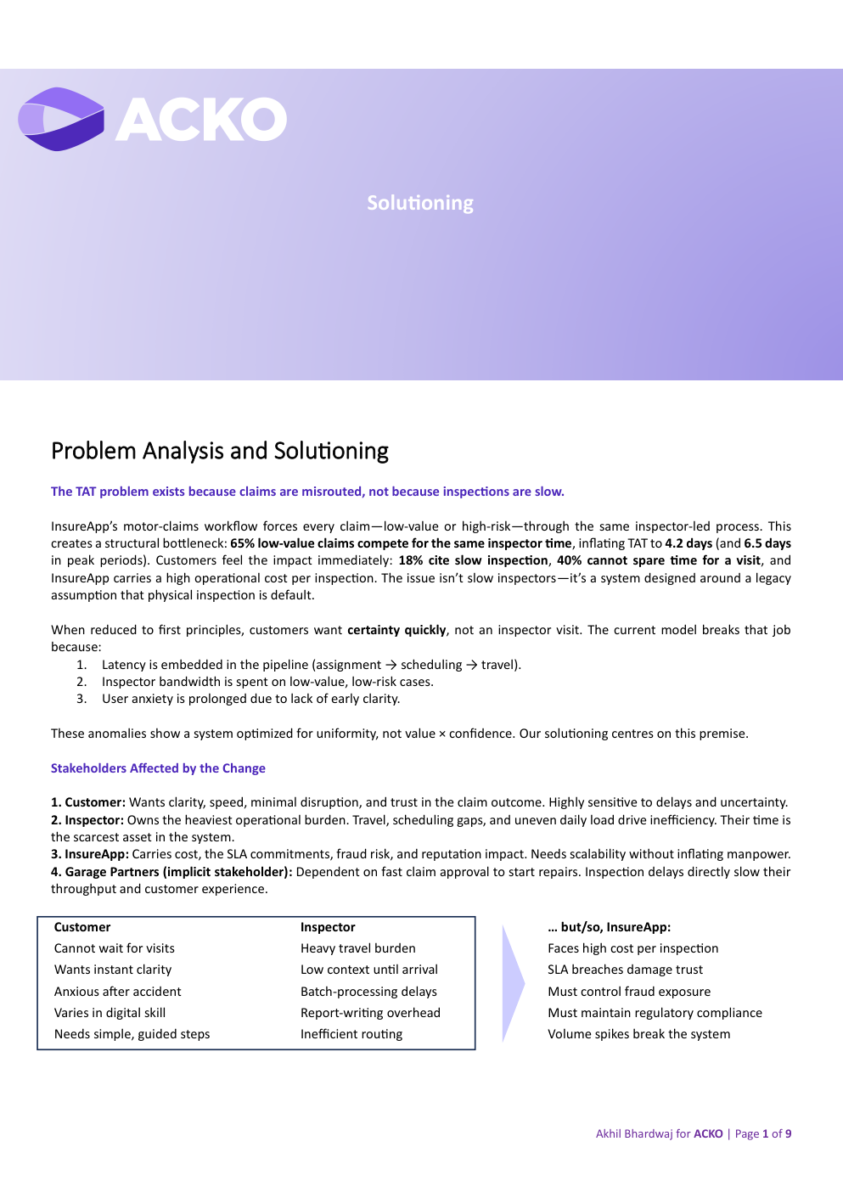
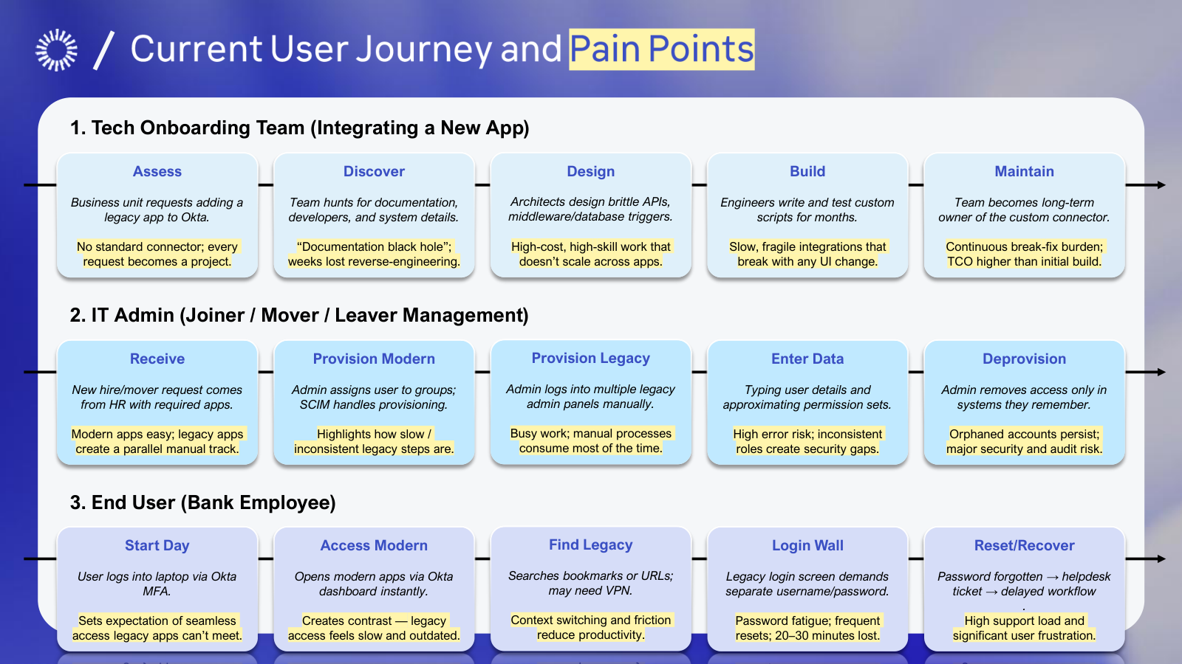
AI can’t think in first principles
Communicating your IDEA
A whiteboard and five interviews. No model starts here.
Claims are misrouted, not slow. That reframe was the crux.
15 pain points. We asked people, we didn't prompt (or did we?)

Slide 14
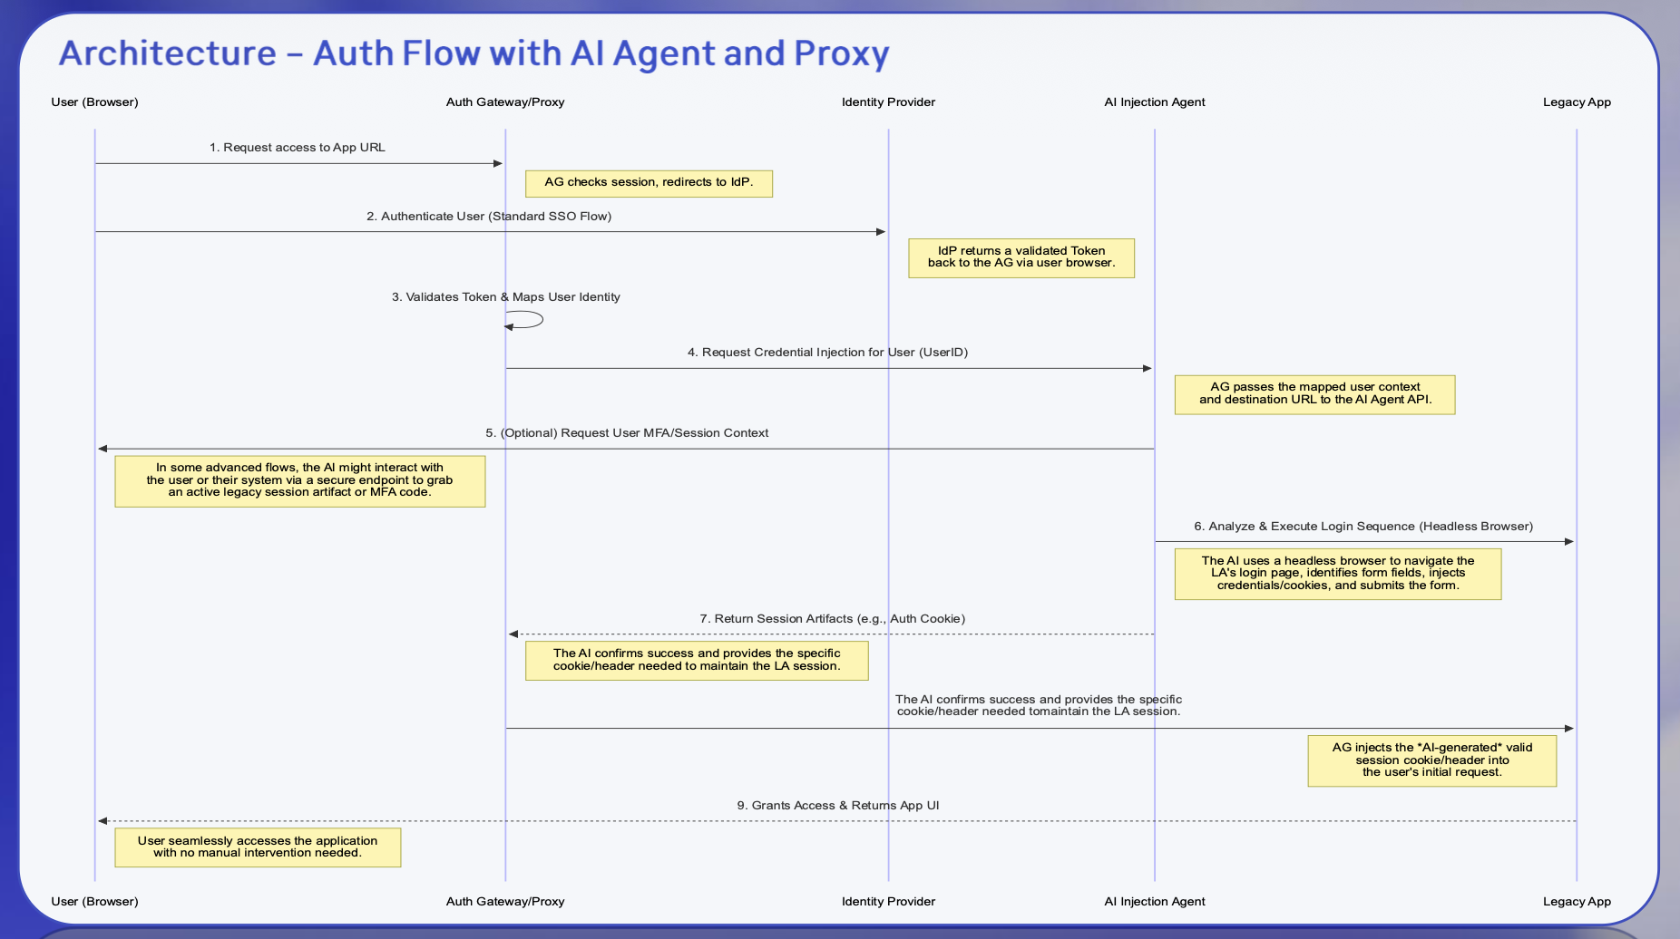
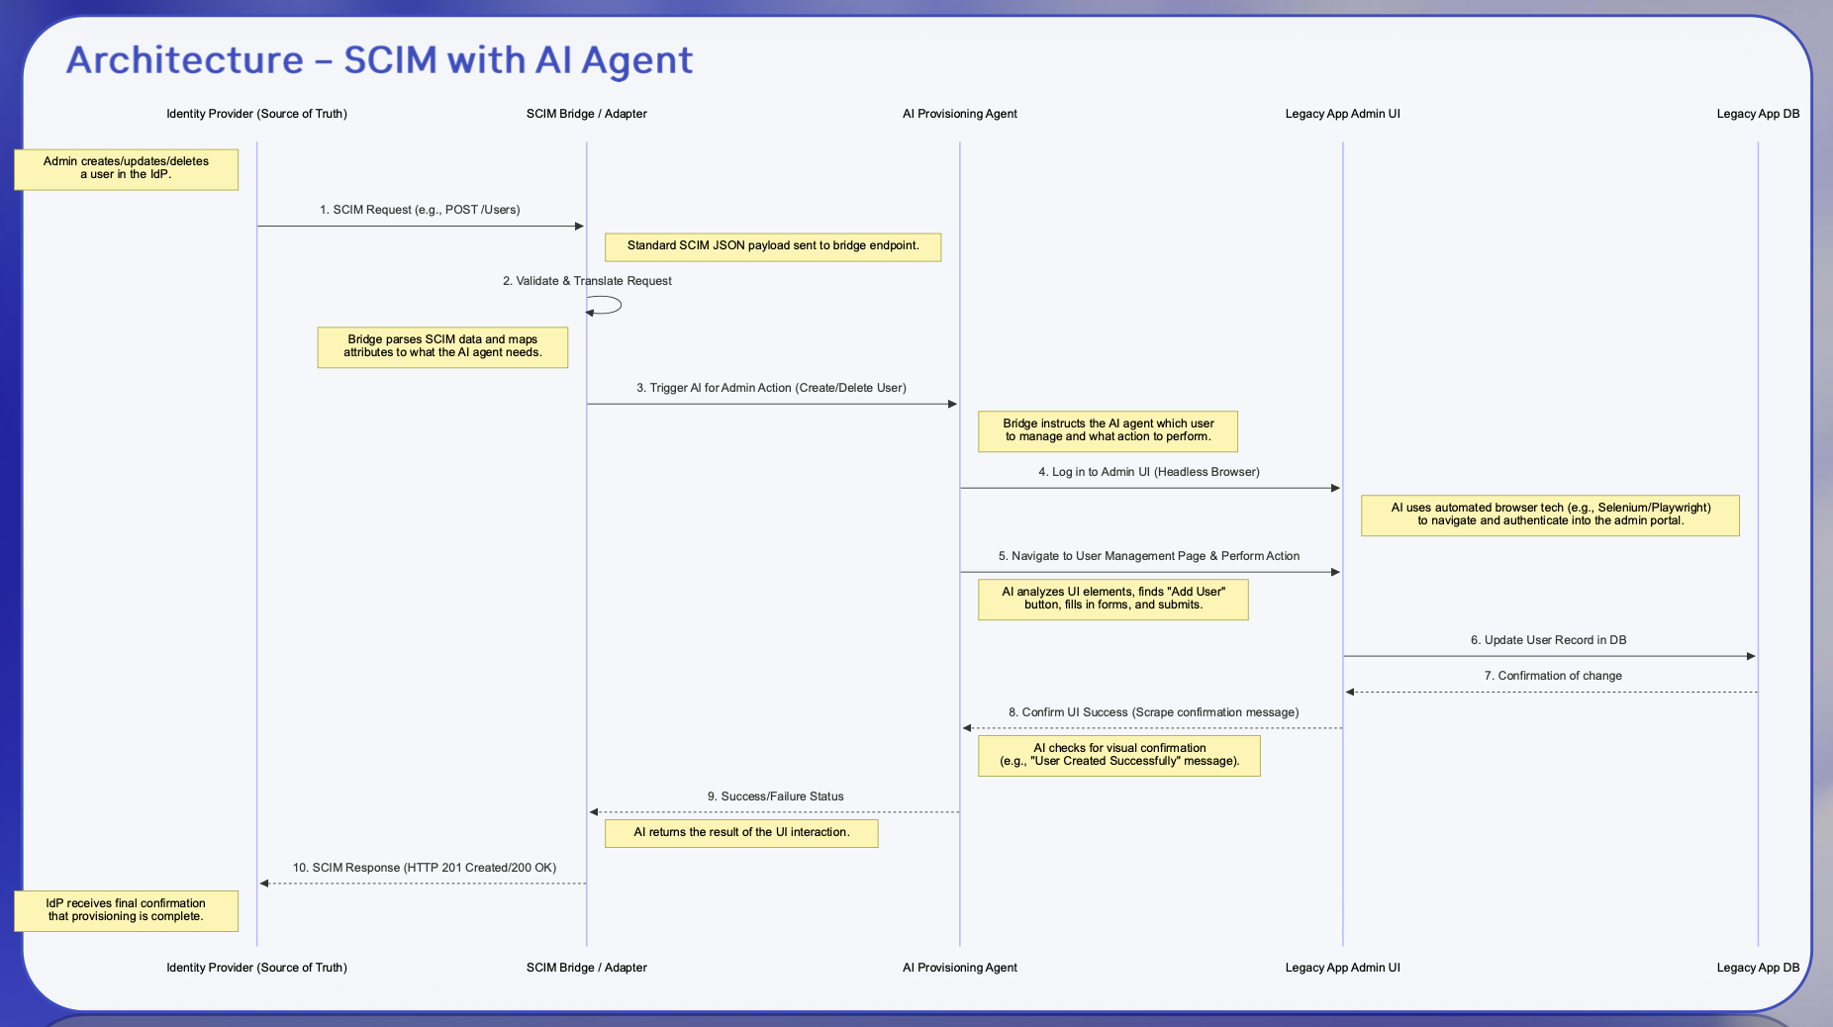
AI is amazing at filling in the blanks
Communicating your IDEA
We knew the horizontal, but not the vertical
AI checked we hadn't missed anything under them.
That's the division of labour.

Slide 15
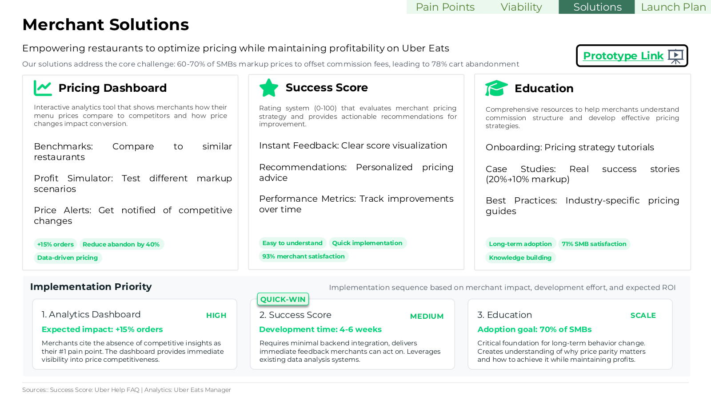
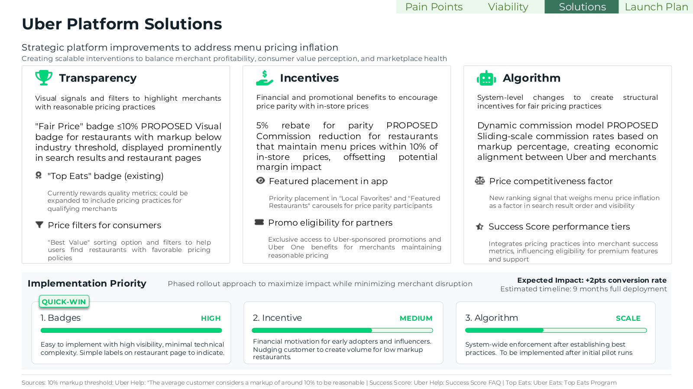
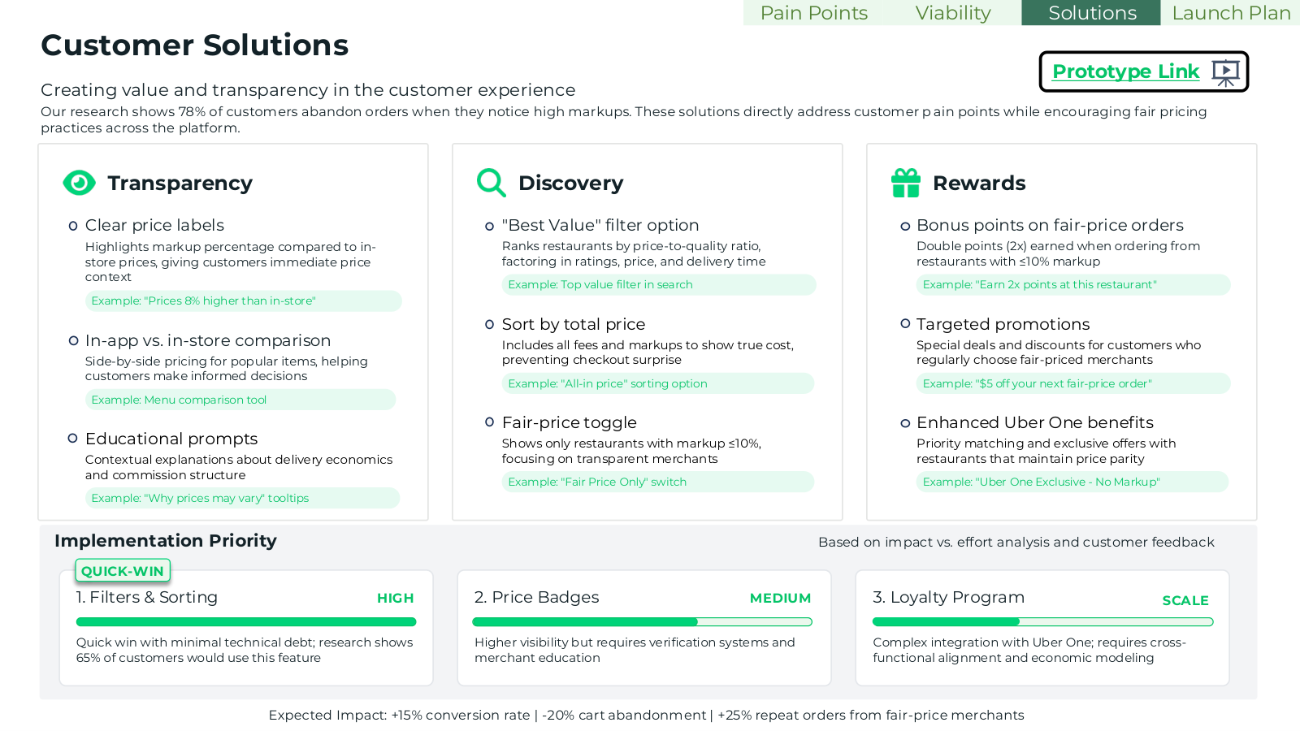
AI is amazing at filling in the blanks
Communicating your IDEA
Merchant, platform, customer.
Same structure each time.
Nothing dropped. This is the job AI is actually good at.

Slide 16
Winning with AI is a function of intent.

Slide 17
Your decks won’t pass if you…
Create a first draft with AI …
Run the most detailed deep research to begin with …
Use Claude Design, Gamma etc. to design your slides …
… because you’ll bias your thought process
… because you’ll solve for data and not logic
… because they follow unintuitive, non-human design languages
Instant Gratification Overvalued Slop

Slide 18
… but if you leverage your two brains
Manually brainstorm unique solutions …
Don’t think in answers, but pain points …
Create an intuitive storyline and slide flow …
… and validate your logic with AI
… and use Claude to expand the list for misses
… and ask Gemini to point out visual improvements
Uniquely Creative Expanded and Validated

Slide 19
Think of the narrative, the flow, then the content

Slide 20
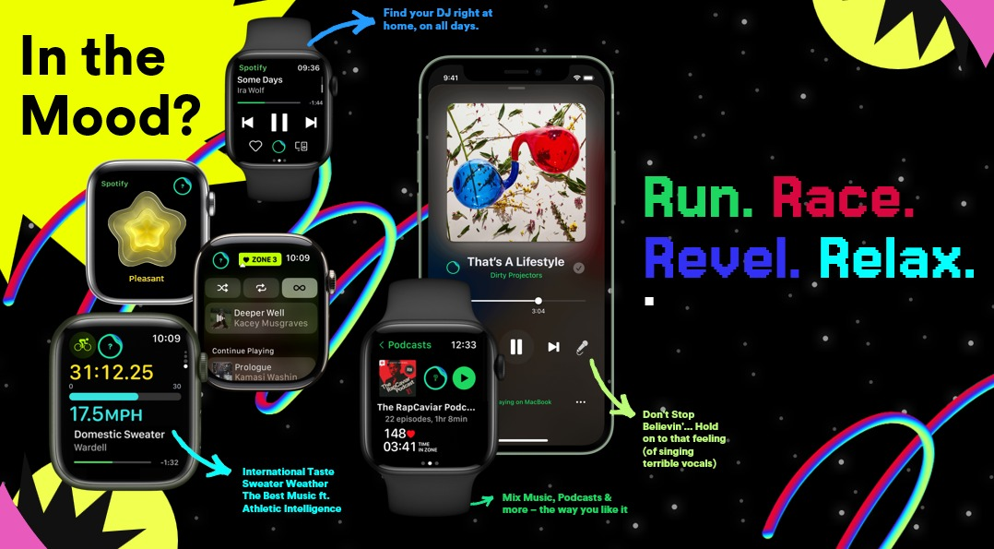
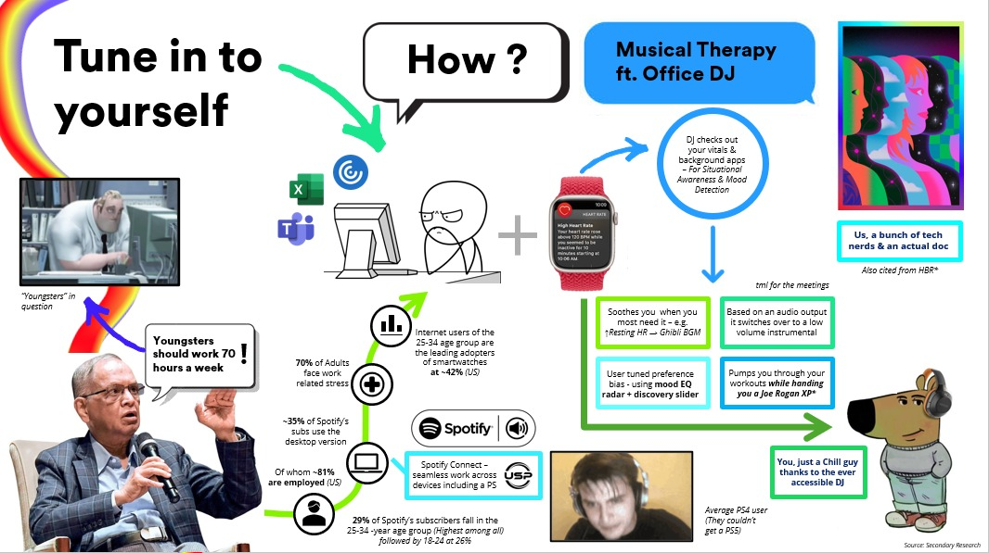
Narratives are about selling a solution
Bias the reader
Bias the reader to our ideal state prototype
Tune into yourself.
How? Musical therapy
Positioning? Chill guy

Slide 21
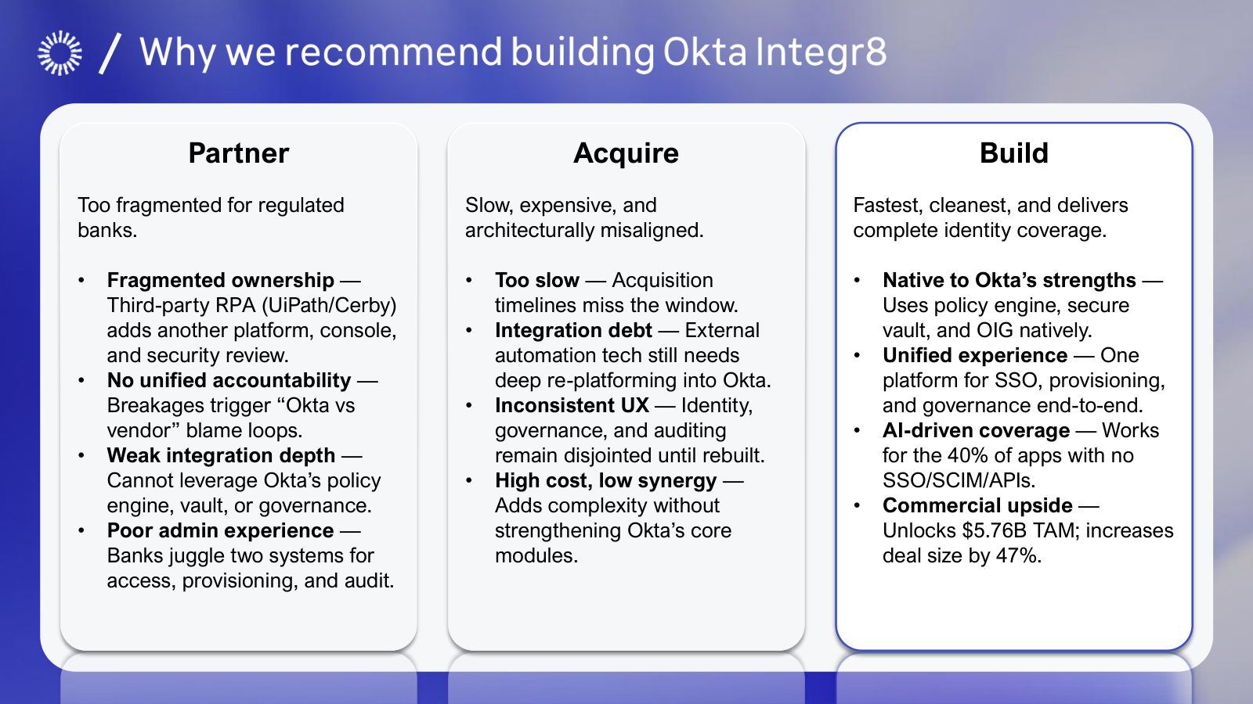
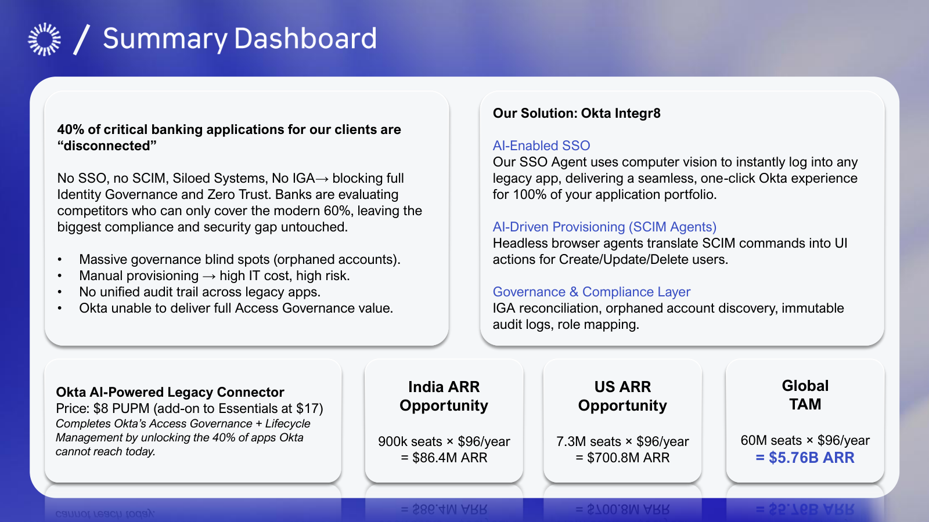
Narratives are about selling a solution
Bias the reader
Three options. One's in a box. You've already chosen. Now you tell why.
Problem and answer on slide two. Everything after is support.

Slide 22
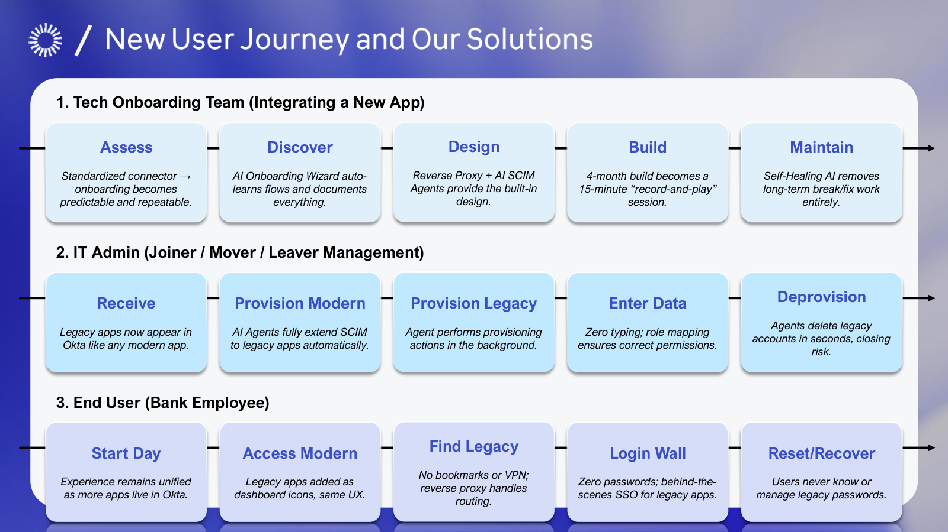
Arrange information to fit the narrative
Tell a story
Same grid, pains in yellow. Now the problem has a shape.
Same grid, yellow gone. We never explain it twice.

Slide 23
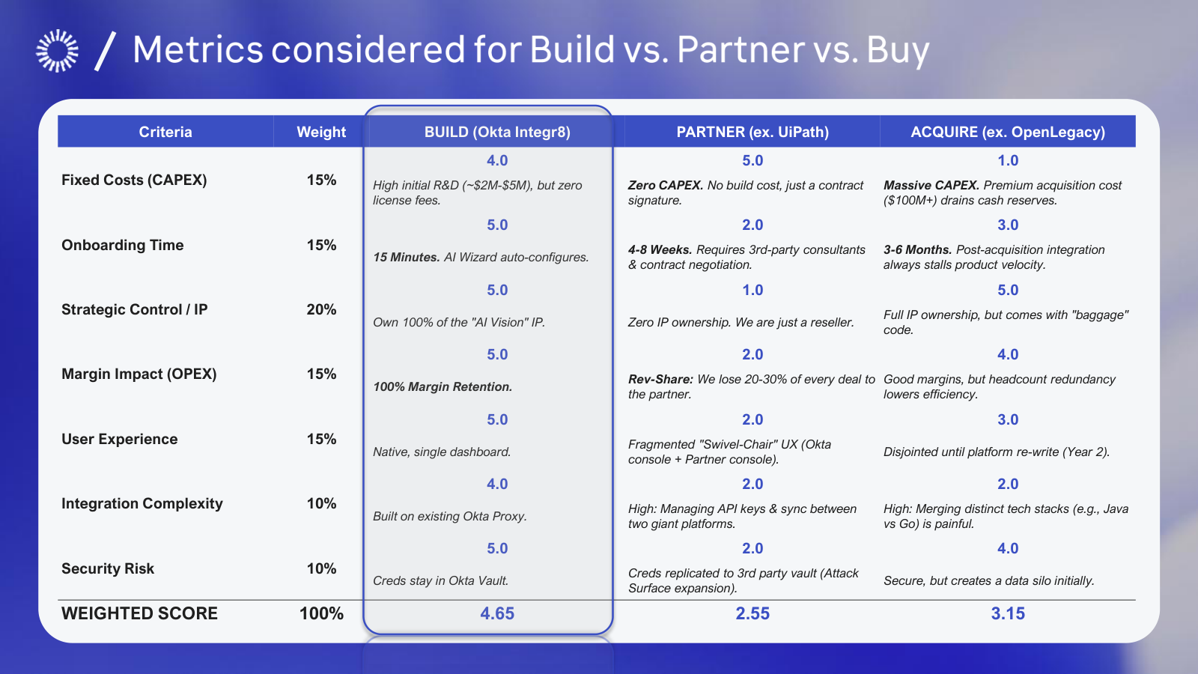
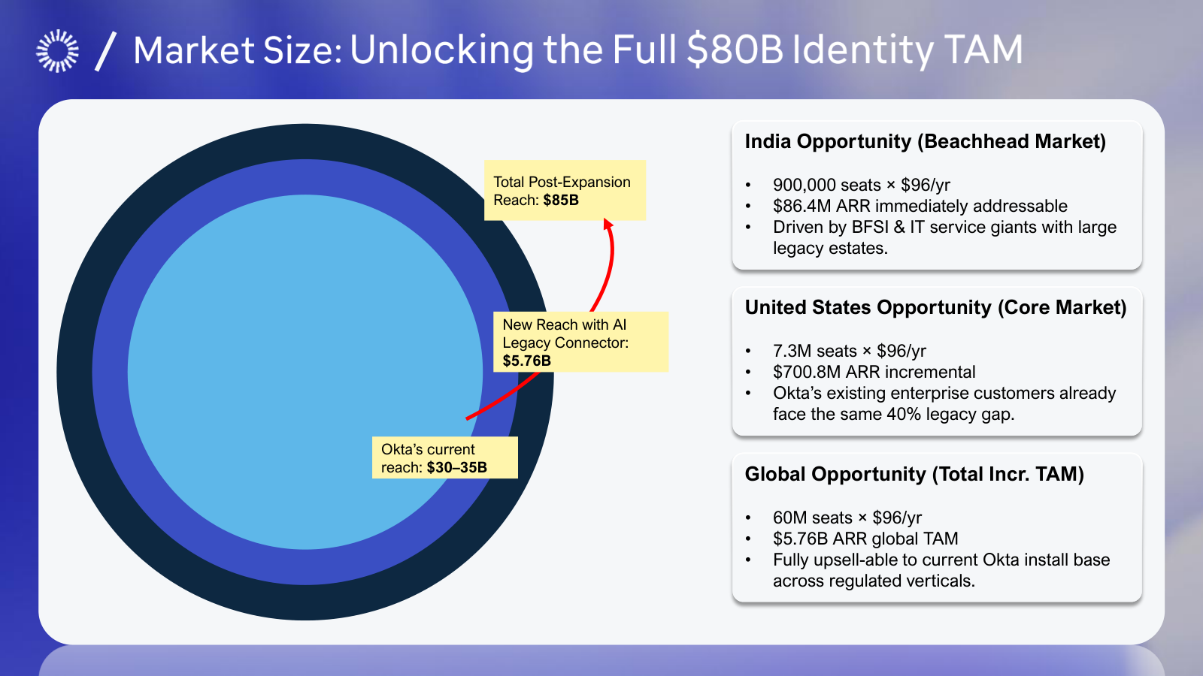
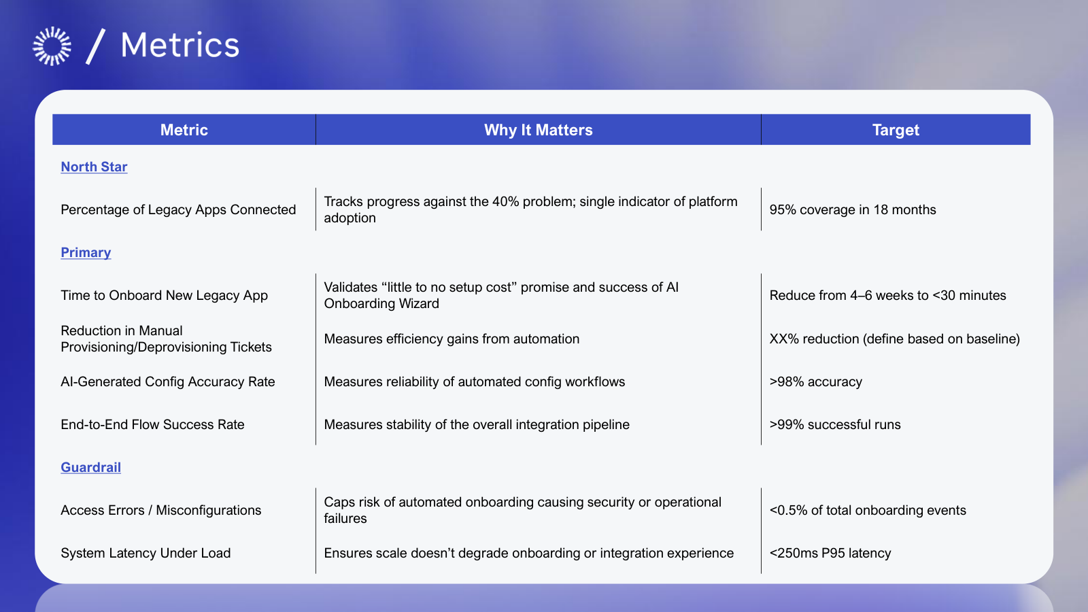
Good content solidifies your storytelling
Drive conviction
4.65 against 3.15. Now it isn't an opinion.
$5.76B, sized three ways. Hard to argue with it now.
North star, primary, guardrail. We thought about being wrong.

Slide 24
Slide-making has a few non-negotiables

Slide 25
If I only read this line, I’d get the point
Section
Section
Section
Section
1
2
3
4

Slide 26
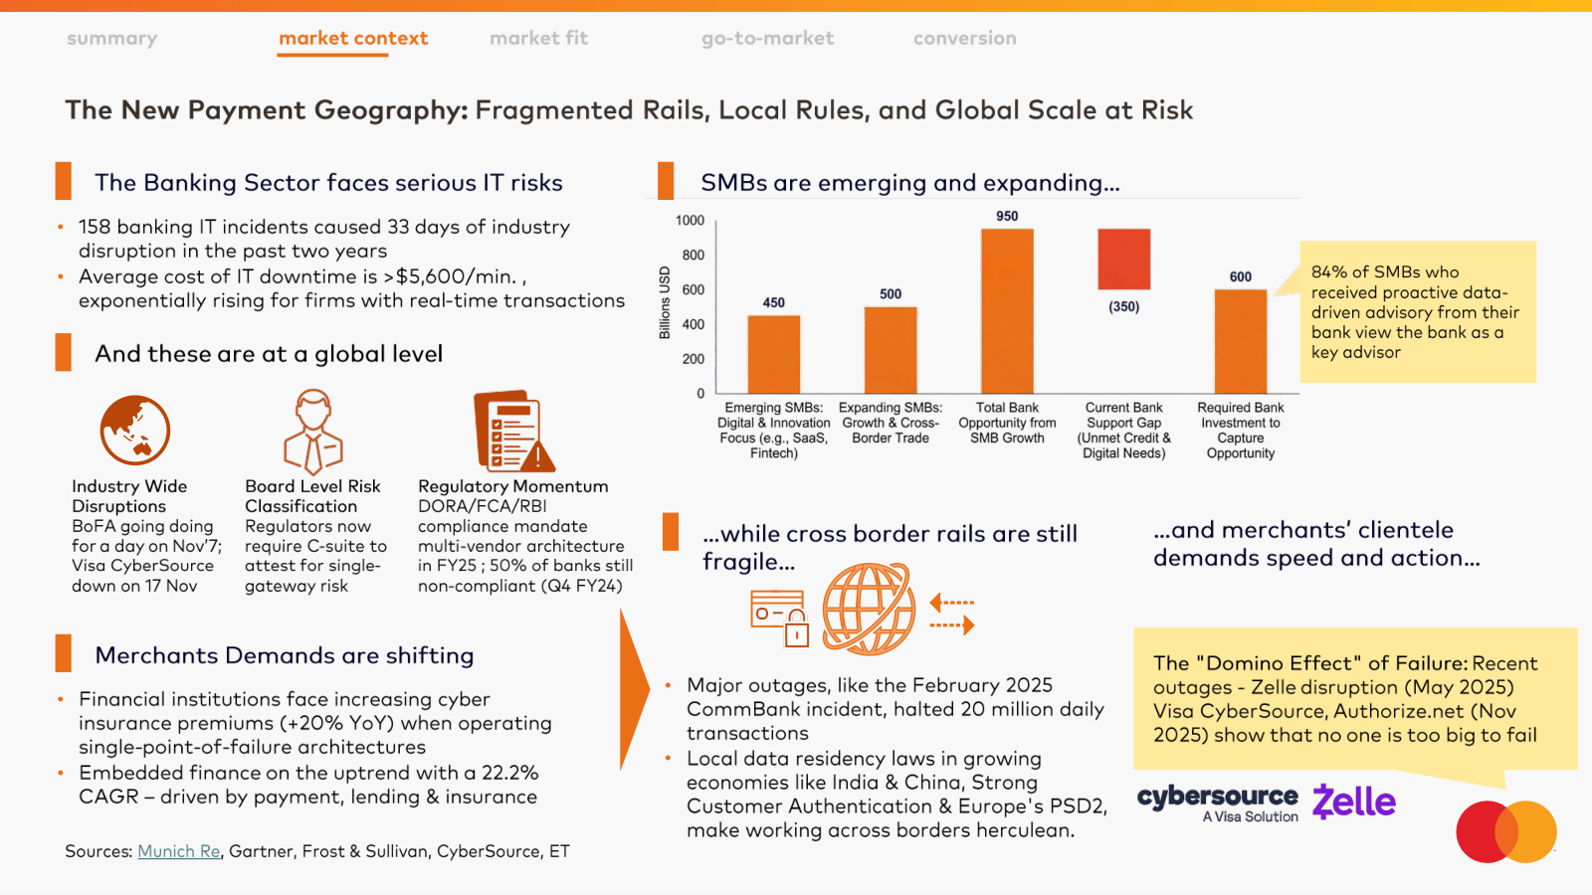
If I only read this line, I’d get the point
Section
Section
Section
Section
1
2
Nav on top, action title below. You always know where you are.
3
4

Slide 27
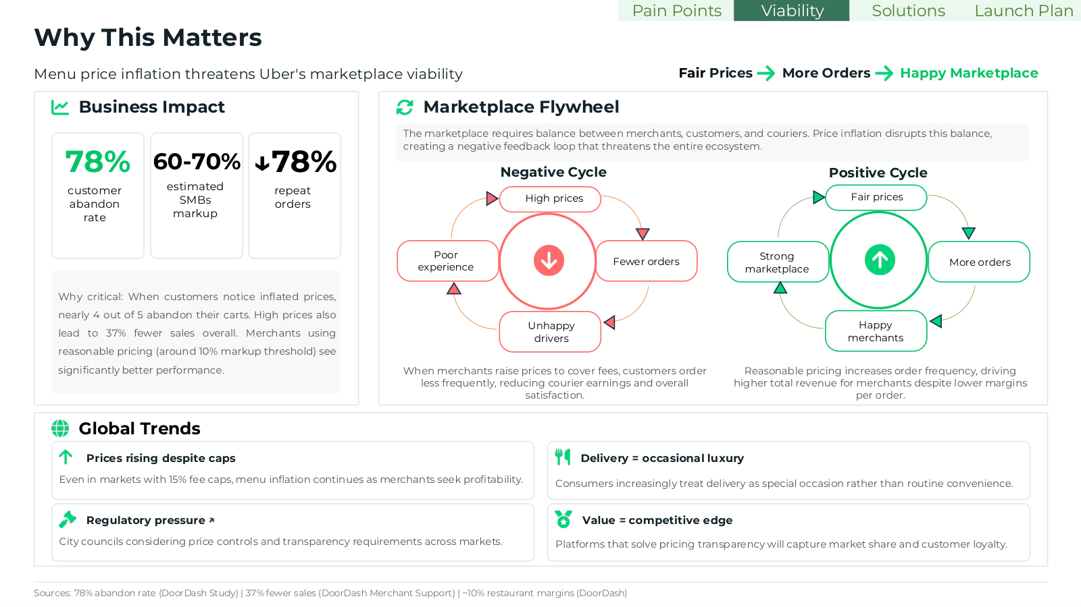
If I only read this line, I’d get the point
Section
Section
Section
Section
1
2
Tabs track progress. The flywheel earns its space.
3
4

Slide 28
If I only read this line, I’d get the point
Section
Section
Section
Section
1
2
Full-bleed product shots carry it. Text only annotates.
3
4

Slide 29
Decks are a visual reflection of the co.
Netflix
Netflix Sans
Helvetica Neue / Arial
Okta
Aeonik Pro
Space Grotesk
Spotify
Spotify Mix
Helvetica

Slide 30
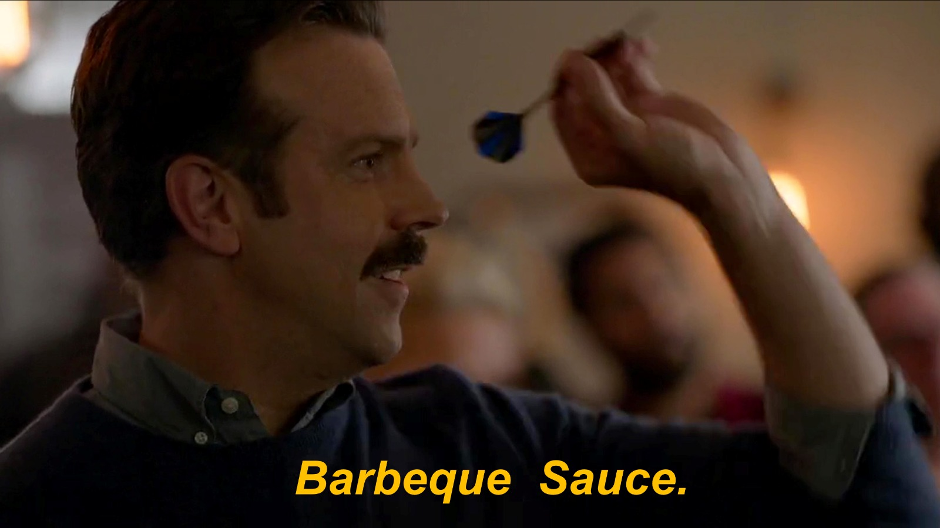
Akhil Bhardwaj / Anuraag Dash
03 October at ISB.
Using AI for PM Decks.

